Slide 1
Activity 6: MORPHOLOGICAL OPERATIONS
Genesis Vertudez – 202003099
App Physics 157 - Computational Analysis and Modeling in Physics
Submitted to Dr. Maricor Soriano; Mx. Rene Principe Jr.

Slide 2
OBJECTIVES
Use ImageJ to manipulate images and extract their features
Apply threshold to grayscale histogram to separate objects from background

Slide 3
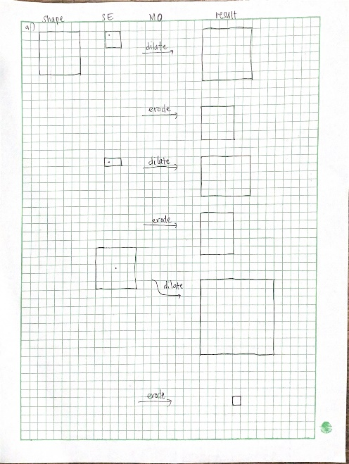
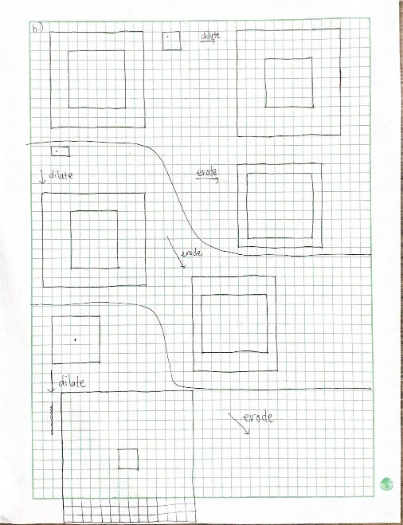
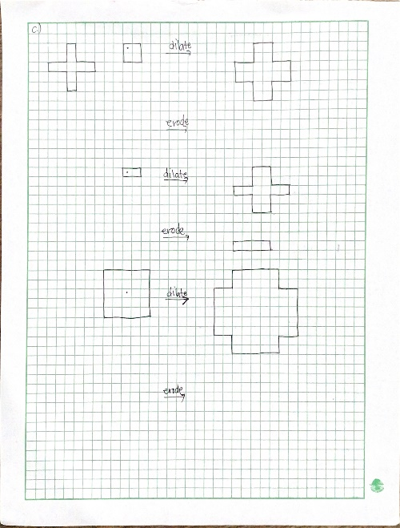
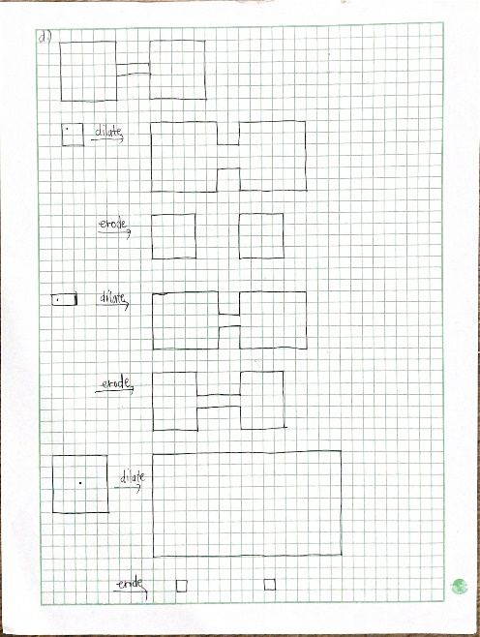
RESULTS & ANALYSIS
Codes and files: https://github.com/genvert/AP_157_FX-2_Vertudez/tree/main/Activity%206

Slide 4
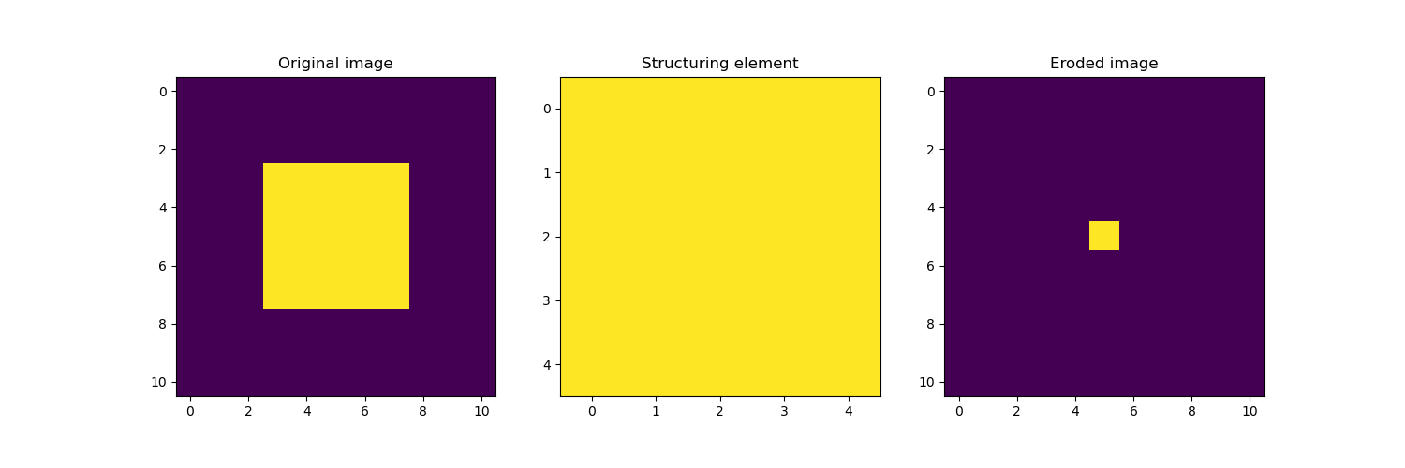
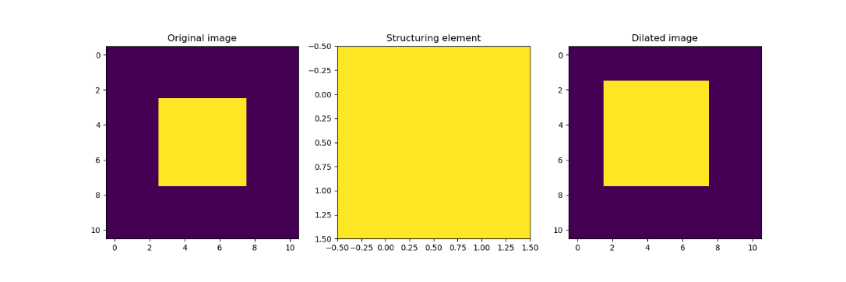
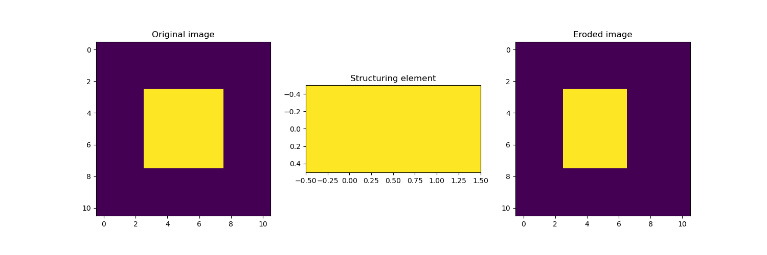
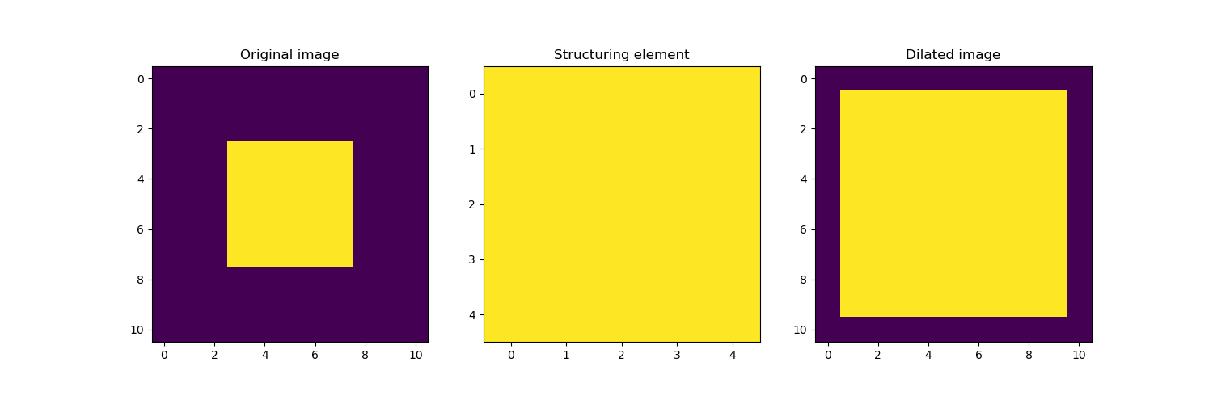
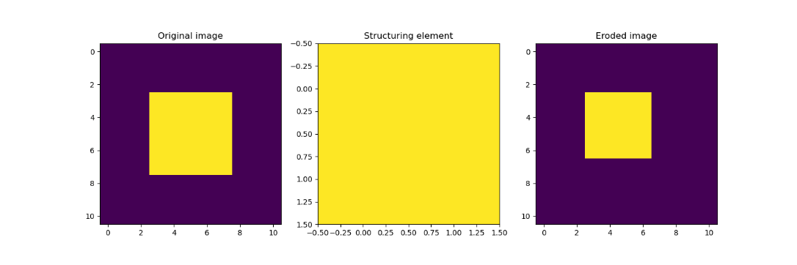
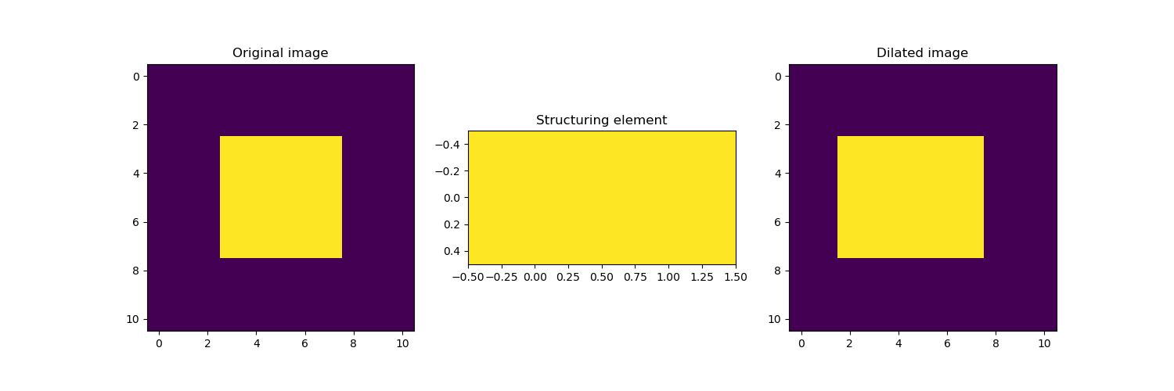
RESULTS & ANALYSIS
Codes and files: https://github.com/genvert/AP_157_FX-2_Vertudez/tree/main/Activity%206

Slide 5
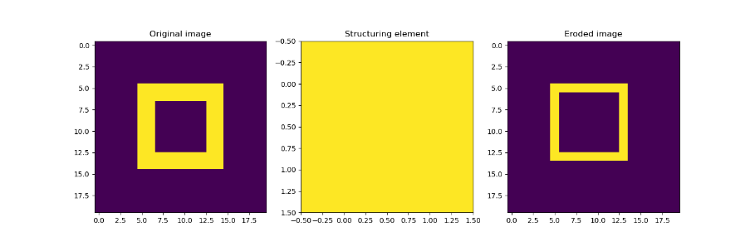
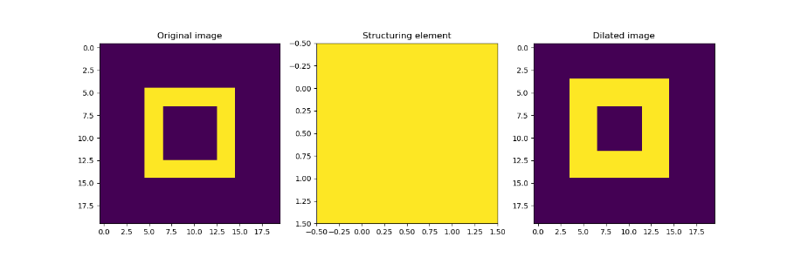
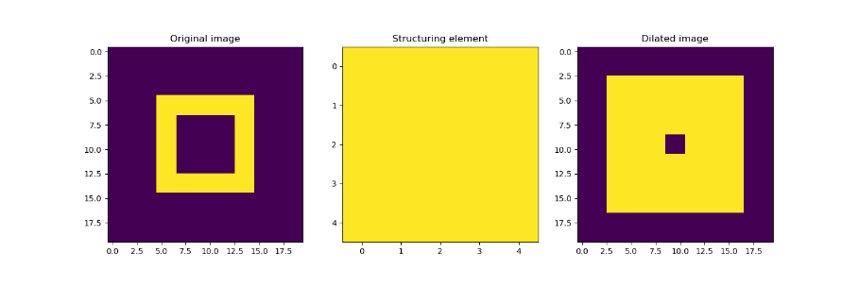
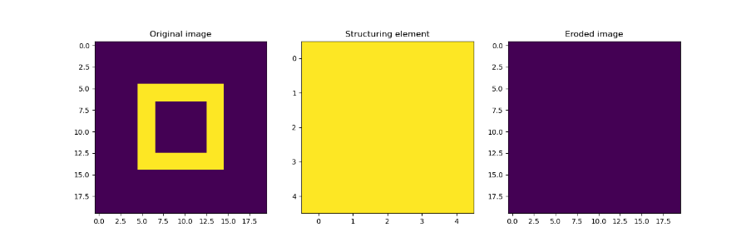
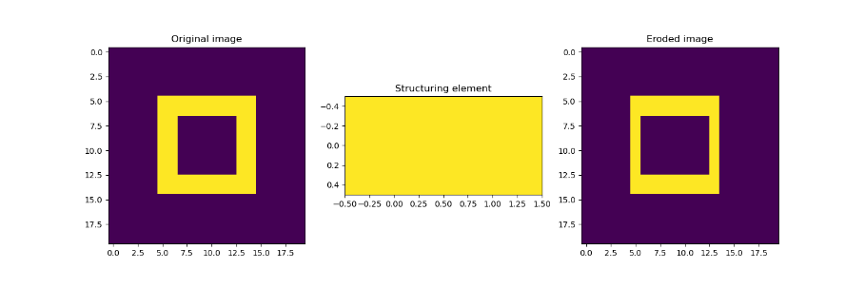
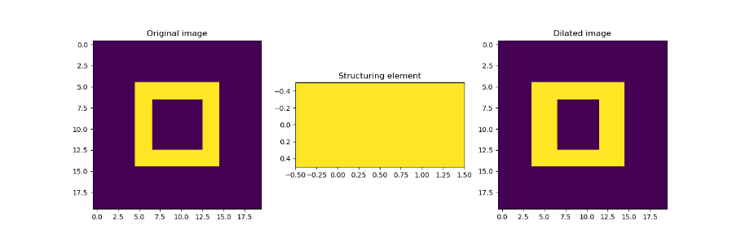
RESULTS & ANALYSIS
Codes and files: https://github.com/genvert/AP_157_FX-2_Vertudez/tree/main/Activity%206

Slide 6
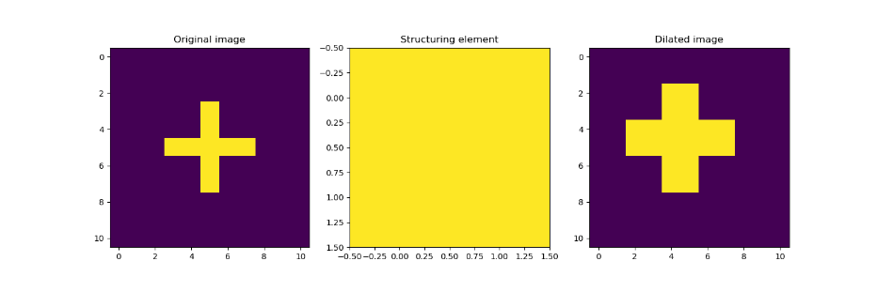
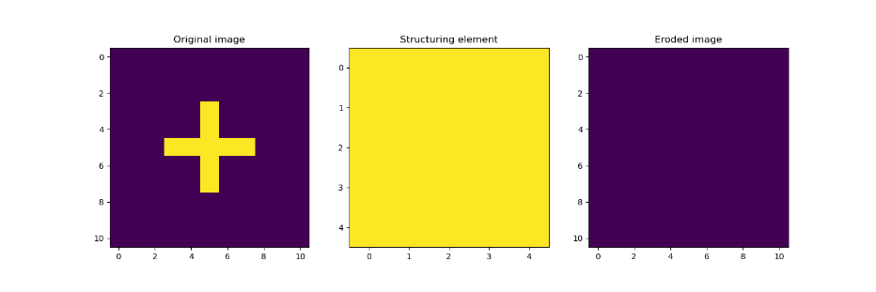
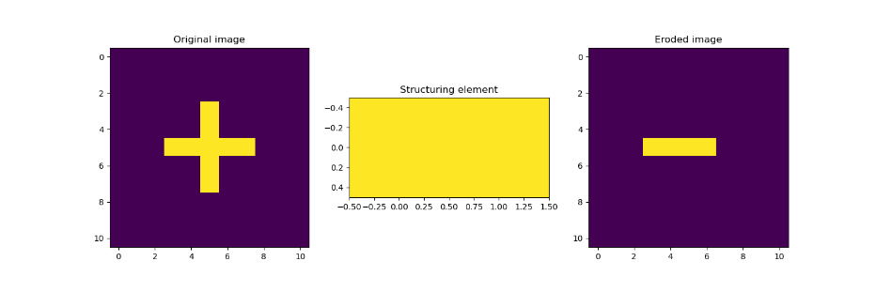
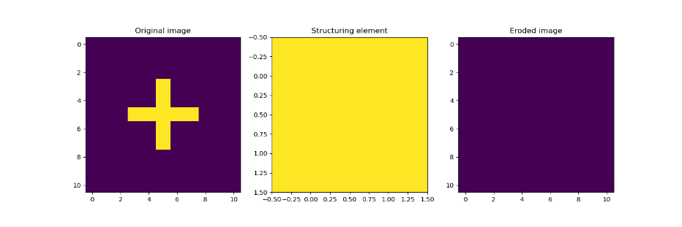
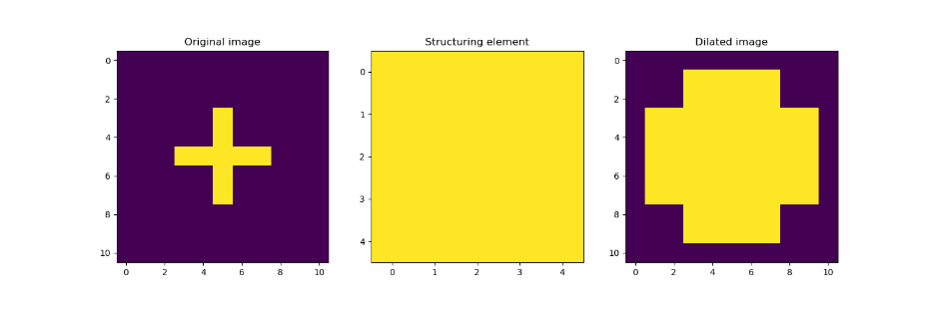
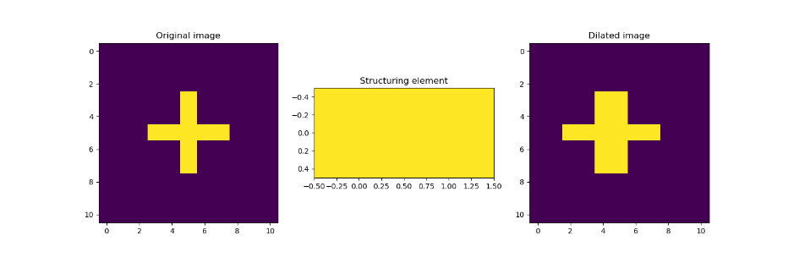
RESULTS & ANALYSIS
Codes and files: https://github.com/genvert/AP_157_FX-2_Vertudez/tree/main/Activity%206

Slide 7
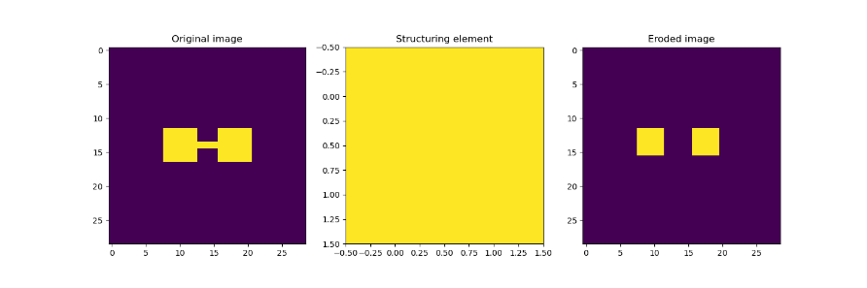
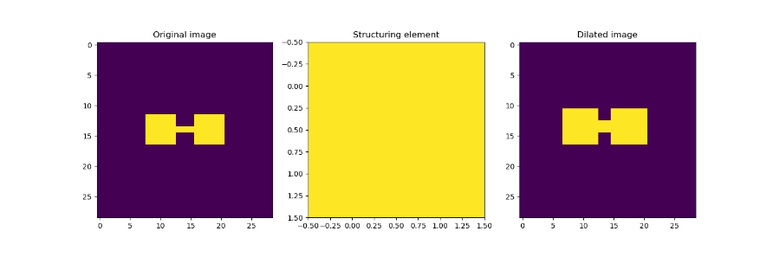
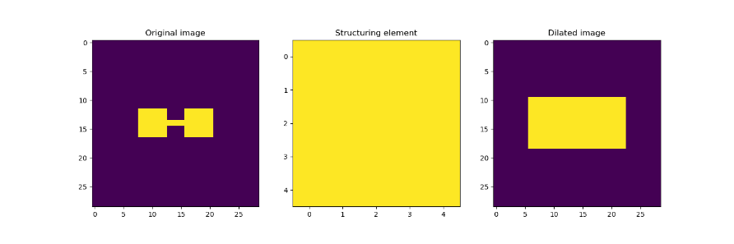
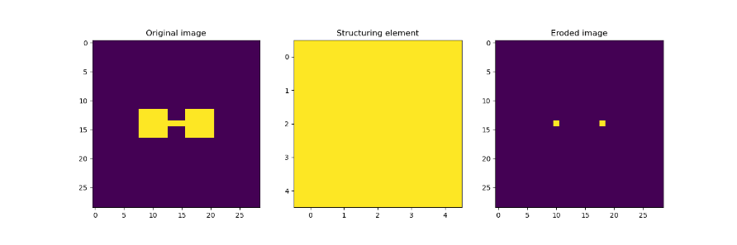
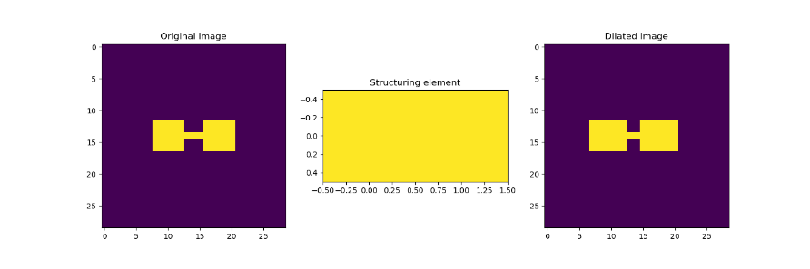
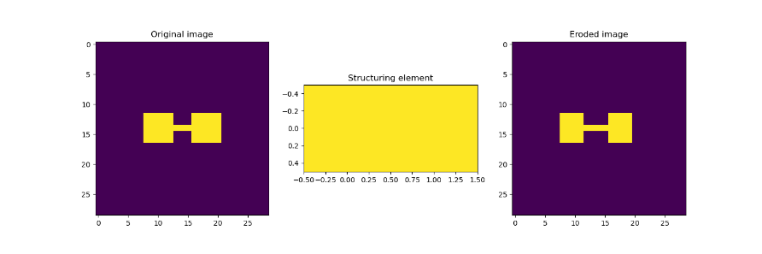
RESULTS & ANALYSIS
Codes and files: https://github.com/genvert/AP_157_FX-2_Vertudez/tree/main/Activity%206

Slide 8
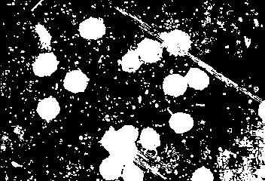
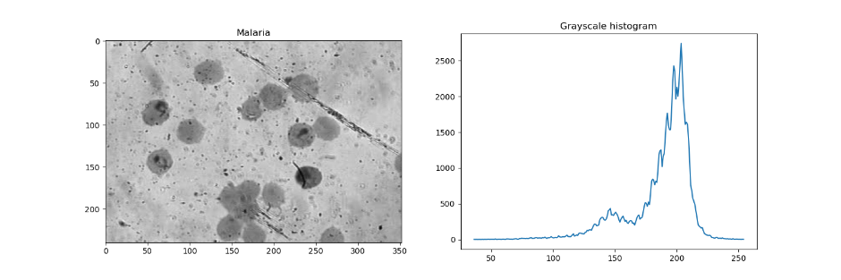
RESULTS & ANALYSIS
Codes and files: https://github.com/genvert/AP_157_FX-2_Vertudez/tree/main/Activity%206

Slide 9
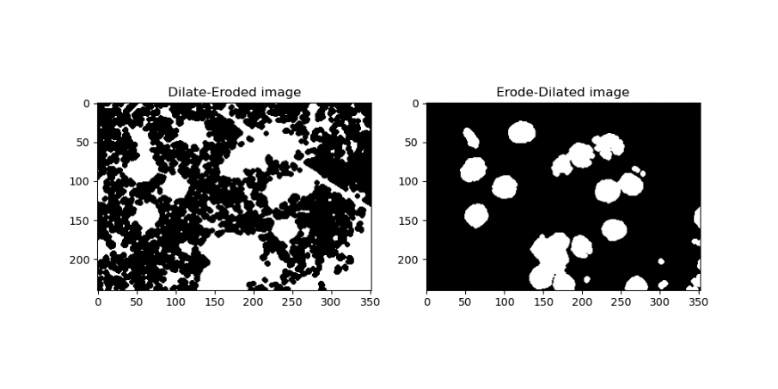
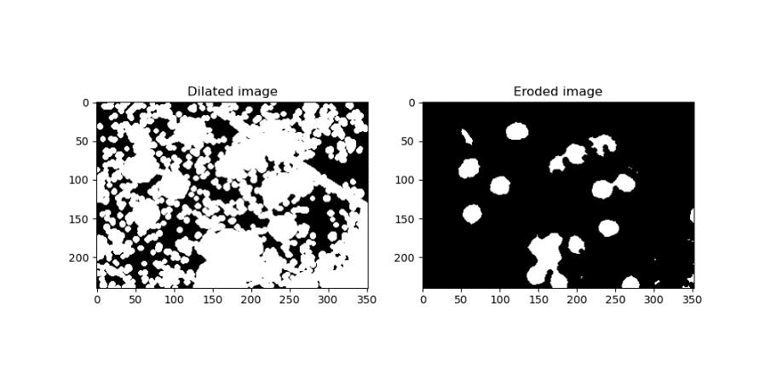

RESULTS & ANALYSIS
Codes and files: https://github.com/genvert/AP_157_FX-2_Vertudez/tree/main/Activity%206

Slide 10
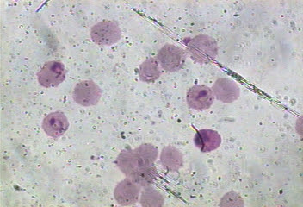

RESULTS & ANALYSIS
Codes and files: https://github.com/genvert/AP_157_FX-2_Vertudez/tree/main/Activity%206

Slide 11
REFLECTION
This activity was straightforward so I was able to follow it easily.
It is fun to recognize and understand the functions of different options in ImageJ based on our fundamental understandings of image processing. It is cool to know that you can do these manually with coding without the app.
I am grateful for this no-coding exercise. This is a breather exercise because I have been overwhelmed by coding lately.

Slide 12
SELF-GRADE
Technical correctness: 35/35
I am confident that I understood how to use ImageJ to extract feature from images, and have applied it.
Quality of presentation: 35/35
I have explained each step, and images are clear and concise.
Self-reflection: 30/30
Even though I was slacking in this subject for a while, I managed to get back on track. The topics are really fun and interesting. It helped me understand the ideas behind image tools such as smartphone cameras, Photoshop, etc.
Initiative: 10/10
I used an extra image for extraction.

